Slide 1
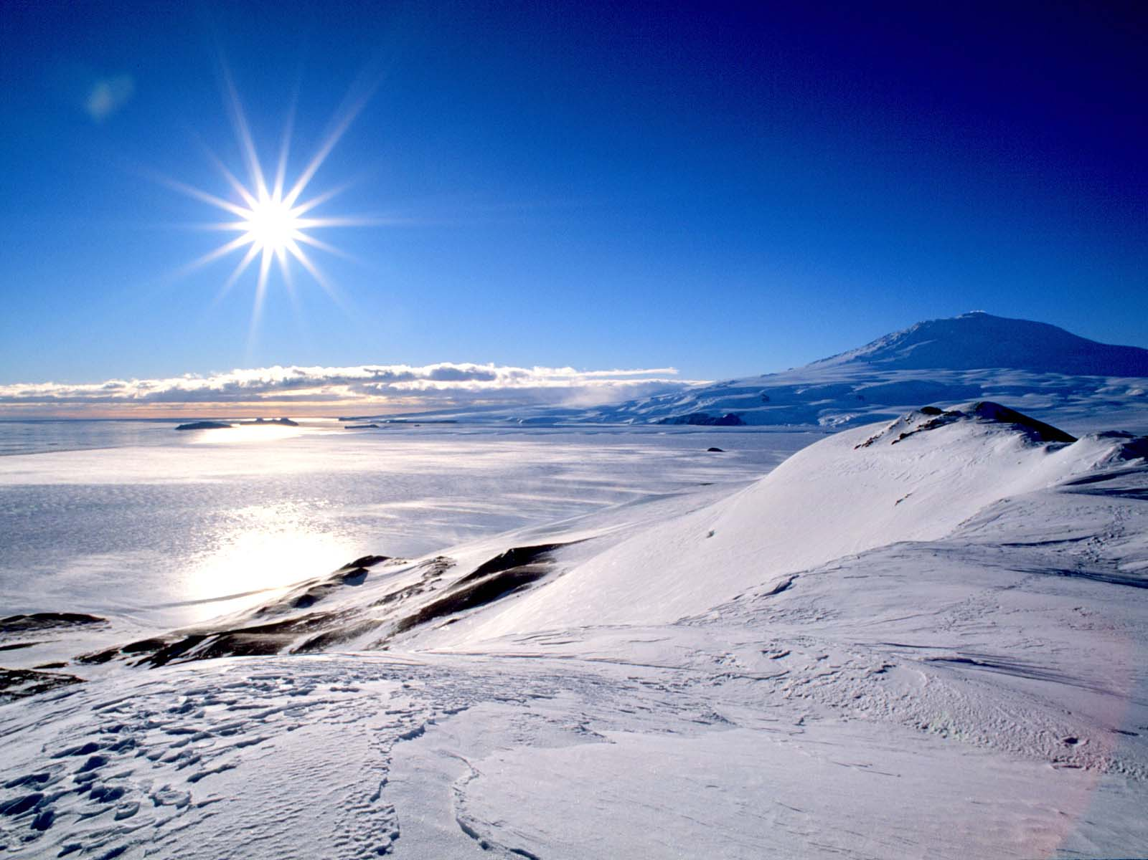


H₂O-CO₂ solubility in basanite: Applications to volatile sources and degassing behavior at Erebus volcano, Antarctica
Kayla Iacovino¹, Gordon Moore¹, Kurt Roggensack¹, Clive Oppenheimer², Philip Kyle³
¹Arizona State University, ²University of Cambridge,
³New Mexico Tech

Slide 2
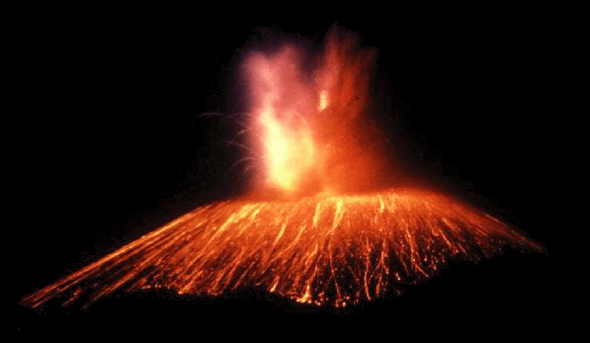
Gas-Rich Volcanoes
H₂O
CO₂

Slide 3
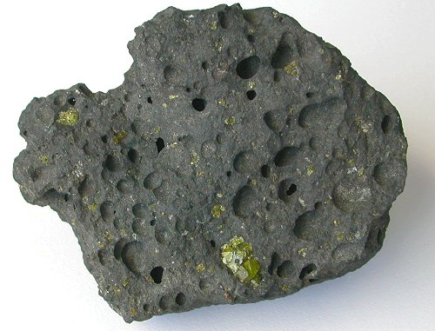
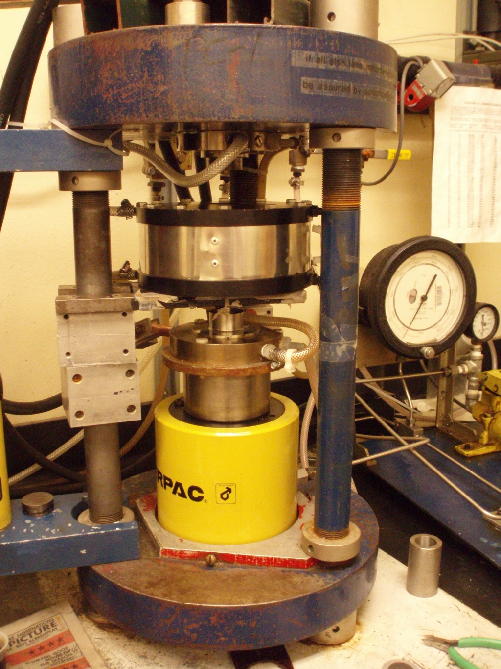
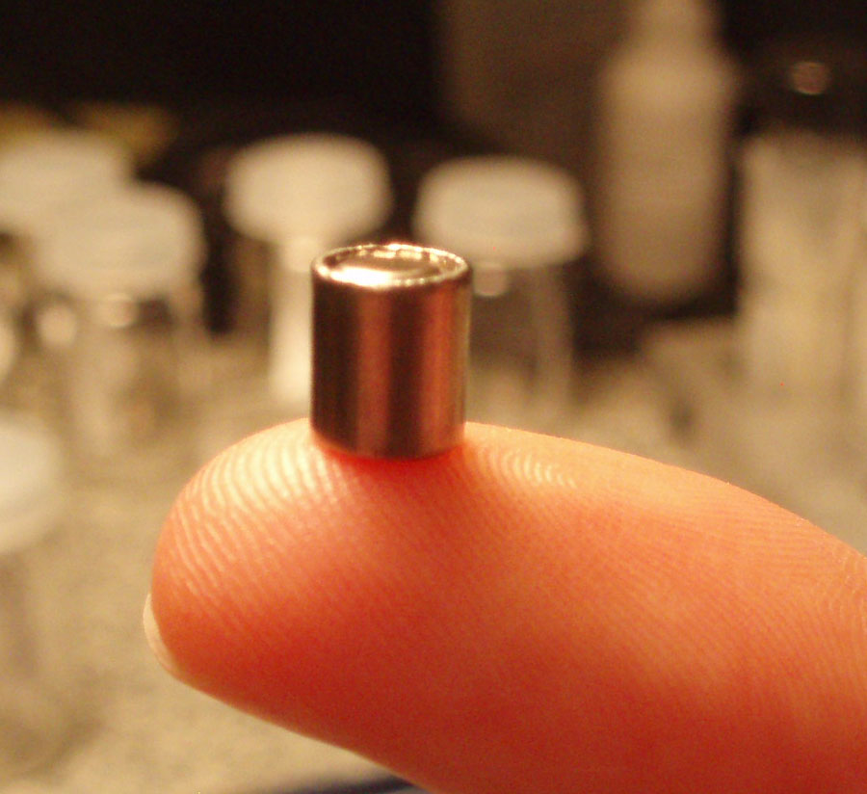
Volcanoes in the lab…
Vesicular basalt
AuPd Capsule
Piston Cylinder

Slide 4
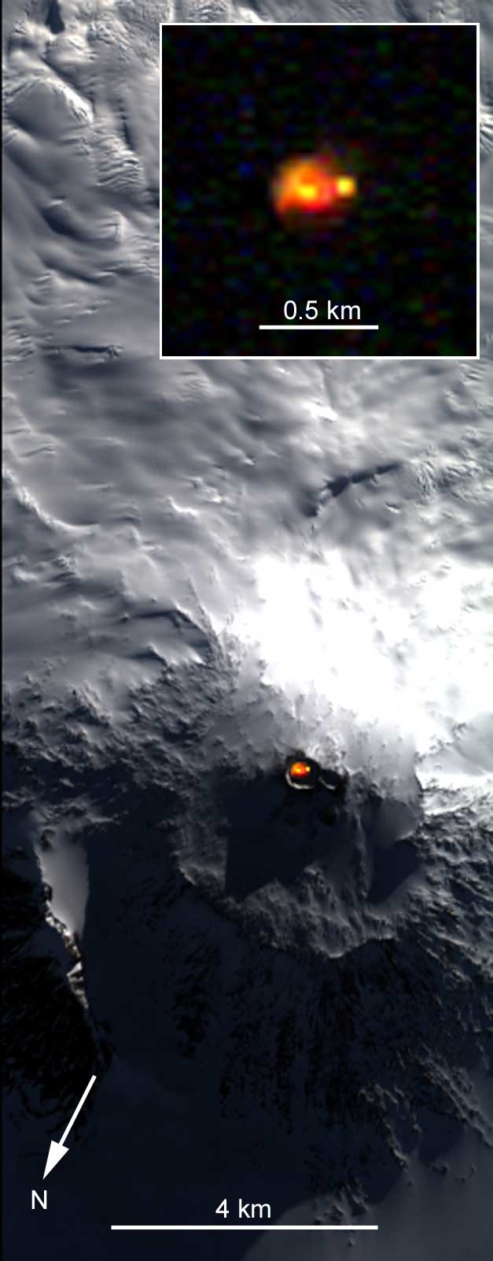
Mt. Erebus
Active volcano with convecting lava lakes
Explosive eruptions with copious amounts of volatiles (CO2, H2O, SO2, HCl) observed by Oppenheimer et al (2008, 2009)
Sequence of lavas from primitive basanite to currently erupting phonolite (Kyle, 1981)
NASA/JPL remotely sensed image

Slide 5
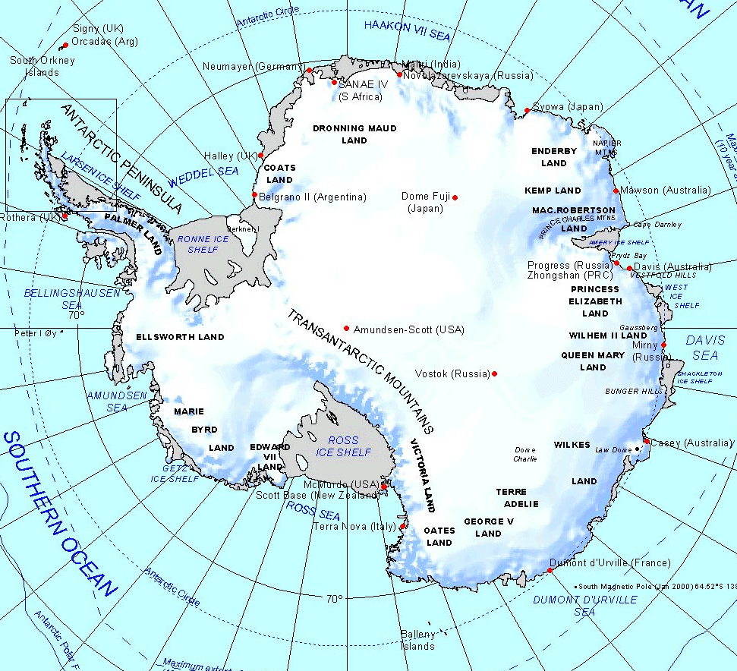
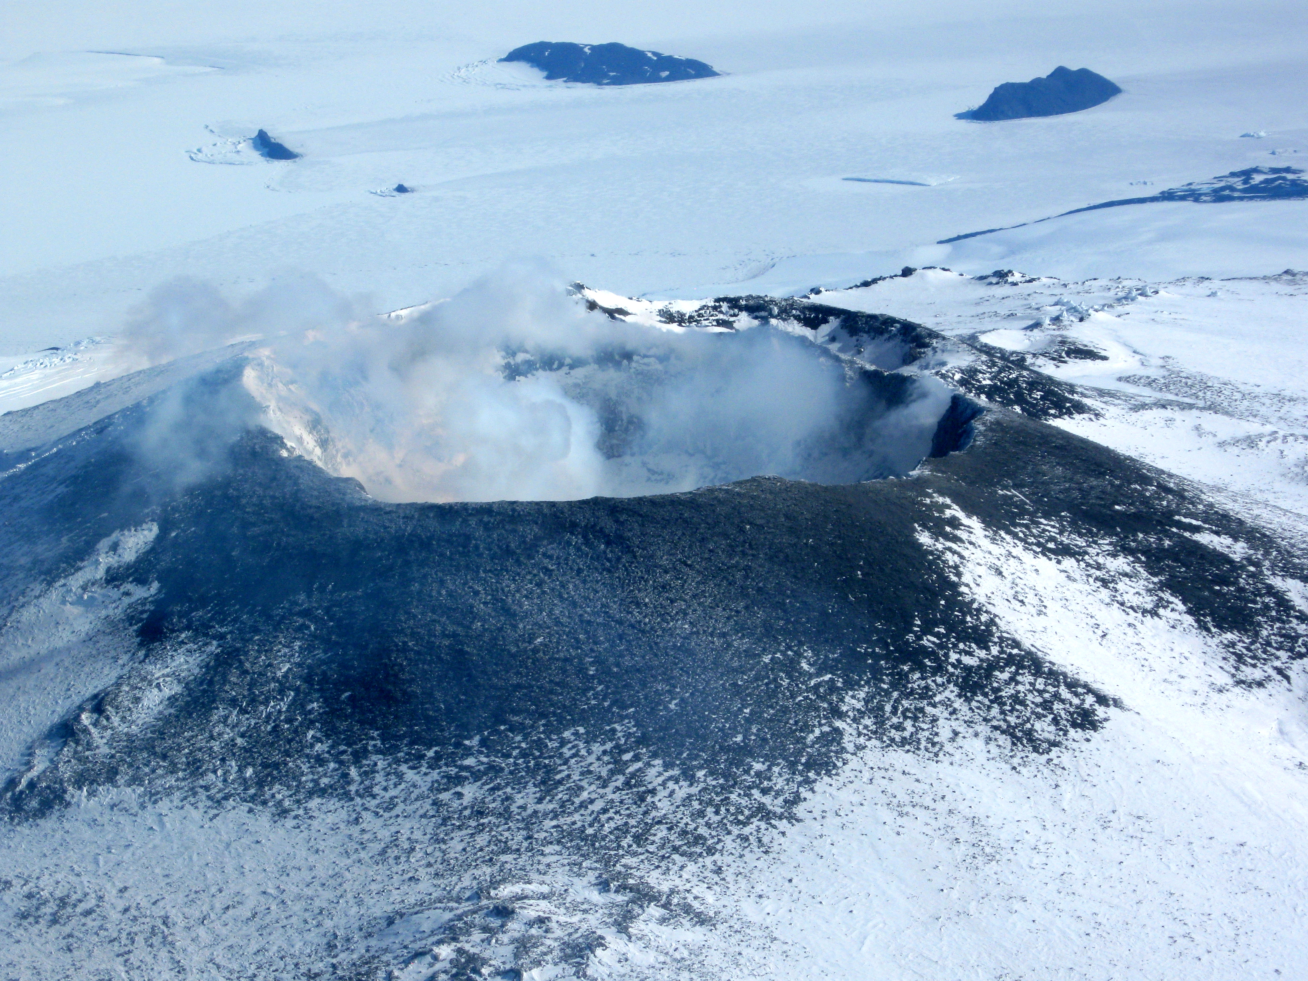
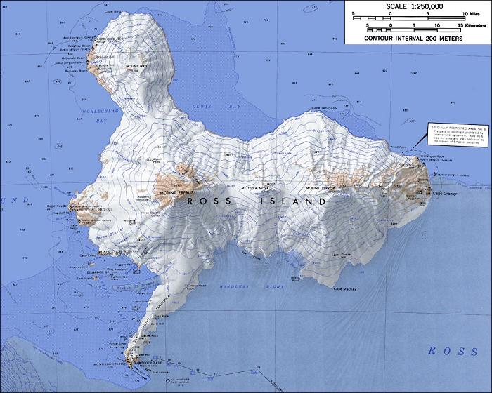

Slide 6
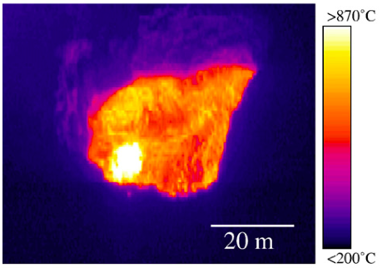
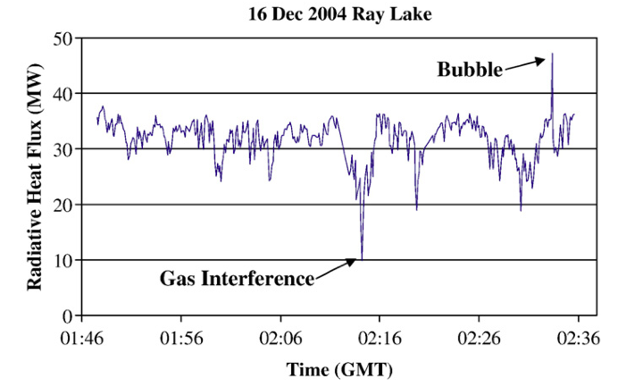
Observations of Explosive Eruptions
Bursting of magma bubble is associated with sudden spike in heat and change in gas composition due to arrival of hot magma
Data from
Calkins et al, 2008

Slide 7
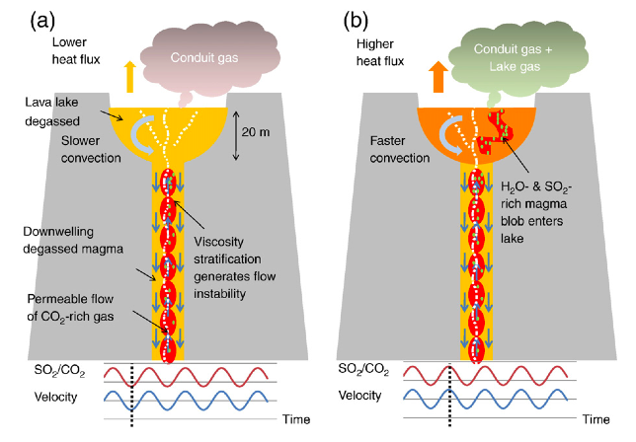
Interpretation
Addition of new packets of hot basanite magma explains observed gas composition and heat flux changes at lava lake
How Deep?
Previous estimates from modeling suggest pressures of 400 MPa (or about 12 km deep)
Oppenheimer et al., Earth and Planetary Sci. Lett. 284 (2009) 392-398

Slide 8
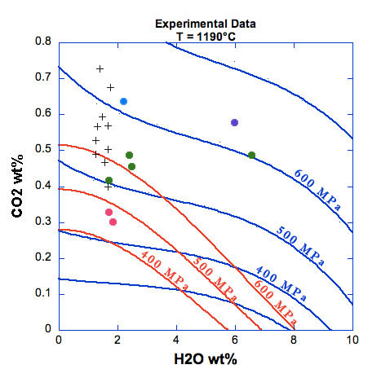
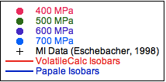
Our Experimental Results
Experiments have similar gas composition to that measured in Erebus basanites
Neither model reproduces our data
Estimated pressure for Erebus ≈ 600MPa (or about 18km deep)

Slide 9
Conclusions
Current models do no reproduce experimental data well
Comparison of experimental data to data from natural Erebus samples indicates a pressure of about 600MPa for Mt. Erebus basanite
Implications for Erebus:
Degassing of gas-rich basanite occurs deeper than previously thought
Acknowledgements
Amber Gullikson, Erika Beam, ASU/NASA Space Grant Program

